Slide 1





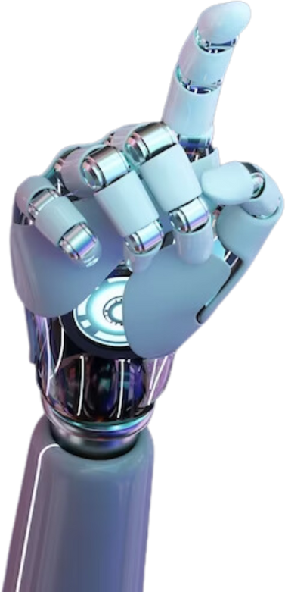



Domain Expert Models
SCAN ME
https://dlweek-hackathon-team-natural-stupidity-domain-expert-models.streamlit.app/
Presented by Natural Stupidity

Slide 2





Typically, ML Models go with a “Bigger is Better Approach”
Inspired by SLMs, we went with an ensemble combination of different “Domain-Expert” Models
User Flow
Upon input, backend calls yFinance to pull the Ticker’s recent price action
User Inputs Ticker that they are
interested in predicting the price
User selects
Domain Expert Model
Model takes in Ticker’s recent price action as input, and predicts closing price for the day
Sentiment analysis is conducted based on the past 7 days, provides a global perspective on an industry
Display key statistics
Playwrite US Modern

Slide 3

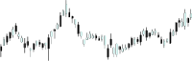



Model Pipeline
User Input of Ticker essentially chooses
which model to use
These form inputs for a Deep Neural Network, which outputs predicted stock closing price of a specific ticker
Multiple single variable LSTM models trained on past 3 year data of an
individual ticker
Combine this with sentiment analysis model which analyzes the past week’s news of how the industry is being valued

Slide 4

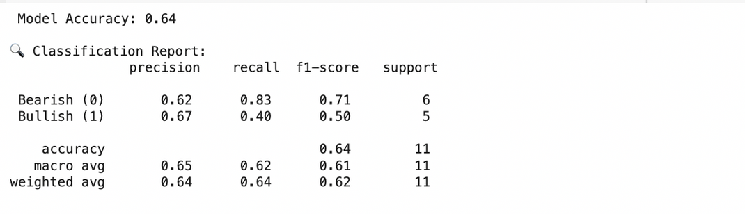

Minimizing Risk with Random Forest Classifier
Feature Engineering and Stock Analysis
Important Technical Indicators
Extracts meaningful insights from raw stock data using technical indicators.
Moving Averages: 10-day & 50-day trends.
Volatility: 10-day rolling standard deviation.
Momentum: 10-day price change.
RSI: Measures overbought (>70) and oversold (<30) conditions.
MACD: Identifies momentum shifts using exponential moving averages.
Trading Volume: Confirms market activity.
Model Implementation (Random Classifier Model)
Preprocessing: Clean & transform data.
Feature Engineering: Add technical indicators.
Training: 80/20 split, model learns to predict Bullish (1) or Bearish (0) trends.
Evaluation: Accuracy improvement through tuning.
Results

Slide 5

We prioritized Technical Indicators
The Fundamentals of Price Prediction
Addressing Overfitting of “Domain Expert” Models
Implemented Feature Normalization
Prevent one factor from dominating others
Simple Architecture combined with an Ensemble Format
The simplicity prevents overfitting, while ensemble models still provide nuance in predictions

Slide 6


Deep Neural Network
The Endpoint of the Ensemble System
What is Deep Learning?
With all the different models contributing,
the DNN aggregates all their results to provide one final input.
A subset of machine learning using neural networks with many layers, capable of learning representations of data with activation functions.

Slide 7



Data Scraping
Data Quality
AI systems heavily rely on quality data for training and decision-making.
We used crawlers to gather social media data from Financial Subreddits and Telegram Stock Channels, before cleaning and processing the data for training sentiment analysis models

Slide 8

Sentiment Analysis
We used a RoBERTa model, optimized for Twitter Sentiment, on our Telegram and Reddit datasets.
Our sentiment analysis model was too large for github - with 340 Million Parameters
https://huggingface.co/raz-1412/tech-stock-sentiment-analysis/tree/main

Slide 9

Thank you

